Slide 1
MACHINE LEARNING PROJECT
CALORIEPRO
Calories Burnt Prediction
A machine learning application to estimate calories burned during physical activity.
PRESENTED BY
INSTITUTE
TECHNOLOGY
Rahul Mohandas
Luminar Technolab
Python • XGBoost • Streamlit
CALORIEPRO • FITNESS INTELLIGENCE • MACHINE LEARNING

Slide 2
01 • INTRODUCTION
Project Overview
• CaloriePro estimates the number of calories burned during a physical activity session.
• It uses details such as age, gender, height, weight and exercise information.
• A machine learning model learns patterns from previously recorded exercise data.
• The application presents the prediction through a simple Streamlit interface.
• The project also includes data analysis and comparison of different regression models.
CALORIEPRO • FITNESS INTELLIGENCE • MACHINE LEARNING

Slide 3
02 • PROJECT BACKGROUND
Problem Statement
• Calories burned can vary from person to person, even during similar activities.
• Factors such as exercise duration, heart rate and body temperature can influence energy expenditure.
• Manual estimates or fixed values may not reflect these individual differences.
• This project explores whether machine learning can learn these relationships from data.
• The output is an estimate and should not be treated as an exact medical measurement.
Project Objectives
• Study and understand the exercise and calorie dataset.
• Clean missing values and prepare the data for machine learning.
• Explore patterns using statistics and visualizations.
• Train and compare four regression algorithms.
• Select a suitable model and integrate it into a Streamlit application.
CALORIEPRO • FITNESS INTELLIGENCE • MACHINE LEARNING

Slide 4
05 • DATA
Dataset Description
TOTAL RECORDS
TOTAL COLUMNS
PREDICTION TARGET
15,000 exercise records
9 columns after combining the data
Calories
• The notebook loads exercise_new.csv and calories.csv.
• The exercise data contains user and activity-related information.
• The target column, Calories, represents the recorded calories burned.
• The notebook combines the exercise columns with the Calories column.
CALORIEPRO • FITNESS INTELLIGENCE • MACHINE LEARNING

Slide 5
06 • DATA UNDERSTANDING
Input Features and Target
MODEL INPUTS
PREDICTION OUTPUT
INPUT FEATURES
Gender
Age
Height (cm)
Weight (kg)
Duration (minutes)
Heart Rate (bpm)
Body Temperature (°C)
TARGET VARIABLE
Calories
This is the numeric value the model learns to estimate from the seven input features.
CALORIEPRO • FITNESS INTELLIGENCE • MACHINE LEARNING

Slide 6
07 • DATA PREPARATION
Data Preprocessing
• Checked the dataset for missing values and duplicate rows.
• Found 150 missing values in Height and 150 in Weight.
• Filled missing Height and Weight values using the mean of each column.
• Removed extra spaces and standardised the Gender text values.
• Converted Gender into numeric form: male = 0 and female = 1.
CALORIEPRO • FITNESS INTELLIGENCE • MACHINE LEARNING

Slide 7
08 • UNDERSTANDING THE DATA
Exploratory Data Analysis
AVERAGE AGE
AVERAGE HEIGHT
AVERAGE WEIGHT
AVERAGE DURATION
42.8 years
174.5 cm
75.0 kg
15.5 min
• Used descriptive statistics to understand the range and distribution of values.
• The average heart rate in the dataset is approximately 95.5 bpm.
• The average recorded calorie value is approximately 89.5 calories.
CALORIEPRO • FITNESS INTELLIGENCE • MACHINE LEARNING

Slide 8
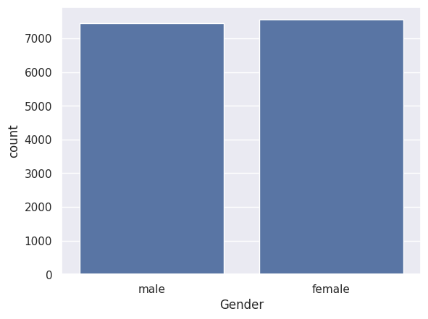
CALORIEPRO APPLICATION
Data Visualisation – User Distribution
Gender distribution in the dataset
WHAT IT SHOWS
The count plot compares the number of male and female records in the dataset.
The two groups are represented in similar proportions.
Source: Colab notebook
CALORIEPRO • FITNESS INTELLIGENCE • MACHINE LEARNING

Slide 9
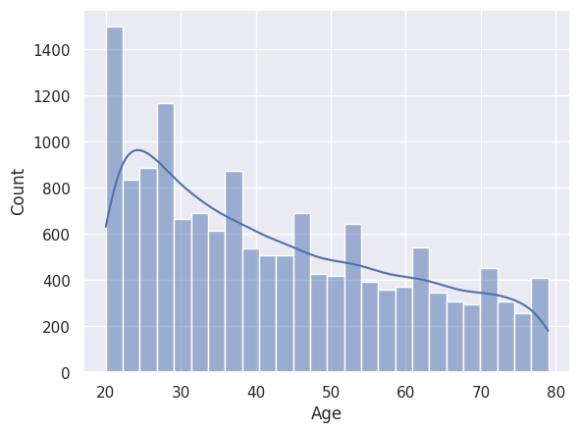
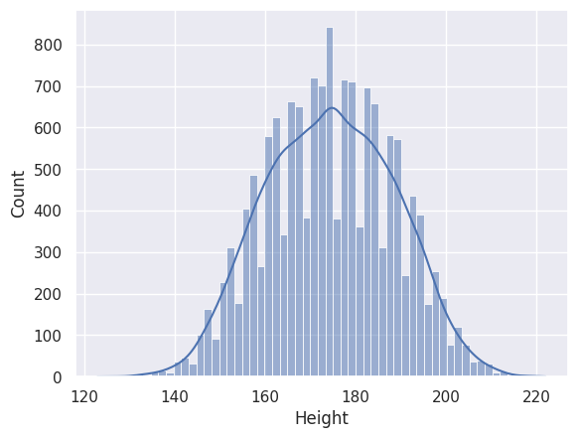
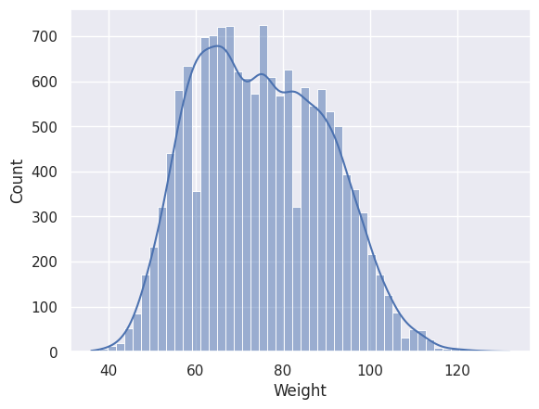
CALORIEPRO APPLICATION
Data Visualisation – Duration and Calories
Distribution of numerical features
AGE
HEIGHT
WEIGHT
Histograms show how values are spread across the records. They help identify common ranges and variation in the dataset.
CALORIEPRO • FITNESS INTELLIGENCE • MACHINE LEARNING

Slide 10
09 • MODEL DEVELOPMENT
Machine Learning Workflow
01
02
03
04
Load data
Clean data
Explore data
Encode features
05
06
07
08
Split data
Train models
Evaluate models
Save XGBoost
Training/testing split: 80% training data (12,000 rows) and 20% testing data (3,000 rows).
CALORIEPRO • FITNESS INTELLIGENCE • MACHINE LEARNING

Slide 11
10 • REGRESSION MODELS
Algorithms Used
Linear Regression
Decision Tree
A basic model that estimates a target using a linear relationship.
Uses a series of feature-based decisions to make a prediction.
Random Forest
XGBoost
Combines predictions from many decision trees.
Builds boosted trees in sequence, learning from previous errors.
CALORIEPRO • FITNESS INTELLIGENCE • MACHINE LEARNING

Slide 12
13 • TEST SET PERFORMANCE
Model Comparison Results
Algorithm | MAE | RMSE | Test R²
Linear Regression | 8.385 | 11.402 | 0.9669
Decision Tree | 3.443 | 5.284 | 0.9929
Random Forest | 1.685 | 2.629 | 0.9982
XGBoost | 1.504 | 2.213 | 0.9988
XGBoost achieved the lowest MAE and RMSE, and the highest test R² among the four models.
CALORIEPRO • FITNESS INTELLIGENCE • MACHINE LEARNING

Slide 13
14 • FINAL MODEL
Selected Model – XGBoost
TEST MAE
TEST RMSE
TEST R²
1.504 calories
2.213 calories
0.99875
• XGBoost gave the strongest test results in this notebook comparison.
• The trained XGBoost model was saved as xgboost_model.json.
• The saved model can be loaded by the Streamlit application for predictions.
CALORIEPRO • FITNESS INTELLIGENCE • MACHINE LEARNING

Slide 14
16 • KEY FINDINGS
Insights, Conclusion and Future Scope
INSIGHT 01 • DURATION
INSIGHT 02 • ACTIVITY SIGNALS
INSIGHT 03 • MODEL RESULTS
Exercise Duration shows a strong positive relationship with Calories in the correlation analysis. Longer sessions generally correspond to higher calorie values.
Heart Rate and Body Temperature also show positive relationships with Calories in the dataset. These features provide useful context for the prediction.
XGBoost achieved the best comparison results: lowest test MAE (1.504), lowest RMSE (2.213) and highest test R² (0.99875).
CONCLUSION
FUTURE SCOPE
CaloriePro demonstrates a regression workflow—from data preparation and analysis to model evaluation—integrated into a Streamlit prediction application.
Validate on more diverse real-world data, improve input validation, tune model parameters and monitor prediction errors after deployment.
THANK YOU • QUESTIONS?
CALORIEPRO • FITNESS INTELLIGENCE • MACHINE LEARNING

